Slide 1

Theory of Automata & Formal Languages CS-224
Sir Syed University of Engineering & Technology, Karachi
Department of Computer Science

Slide 2
Nondeterministic Finite Automata
NFA stands for non-deterministic finite automata (NDFA).
It is easy to construct an NFA than DFA for a given regular language.
In NFA there is no need to draw all paths from any state. Instead draw only valid paths
L1 = All words having at least one and at most 3 character length are valid.
a/b
x1
a/b
x2
a/b
x3
x0
NFA
a/b
a/b
x1
a/b
x2
a/b
x3
x0
x4
a/b
a/b

Slide 3
Nondeterministic Finite Automata
L2 = All words that start with a and have at most 3 character length are valid.
a
x1
a/b
x2
a/b
x3
x0
a/b
b
x4
NFA
a/b
a
x1
a/b
x2
a/b
x3
x0
a/b

Slide 4
DFA
The transition from a state is to a single particular next state for each input symbol. Hence it is called deterministic.
Input a
CS
a
x0
x1

Slide 5
DFA
The transition from a state is to a single particular next state for each input symbol. Hence it is called deterministic.
Input a
CS
a
x0
x1

Slide 6
DFA
NDFA
The transition from a state is to a single particular next state for each input symbol. Hence it is called deterministic.
The transition from a state can be to multiple next states for each input symbol. Hence it is called non-deterministic.
Input a
CS
CS-1
a
x0
x1
x0
x1

Slide 7
DFA
NDFA
The transition from a state is to a single particular next state for each input symbol. Hence it is called deterministic.
The transition from a state can be to multiple next states for each input symbol. Hence it is called non-deterministic.
Input a
Input a
CS-1
CS
CS
CS-2
a
a
x0
x1
a
x0
a
x1
x0
x1
a
x2

Slide 8
DFA
NDFA
The transition from a state is to a single particular next state for each input symbol. Hence it is called deterministic.
The transition from a state can be to multiple next states for each input symbol. Hence it is called non-deterministic.
Input a
Input a
CS-1
CS
CS-1
CS-2
a
a
x0
x1
a
x0
a
x1
x0
x1
a
x2
CS-2

Slide 9
DFA
NDFA
Empty string transitions are not seen in DFA.
NDFA permits empty string transitions.
Input a / b
CS
CS-1
CS-2
a/b
x2
x0
^
x1
x0
a/b
x1
a/b
a/b
CS
x2
x3
x0
a/b
x1
a/b
x2

Slide 10
DFA
NDFA
Empty string transitions are not seen in DFA.
NDFA permits empty string transitions.
Input a / b
CS-2
CS
x0
^
x1
x0
a/b
x1
a/b
x2
a/b
a/b
CS
x2
x3
CS-1
x0
a/b
x1
a/b
x2

Slide 11
DFA
NDFA
Empty string transitions are not seen in DFA.
NDFA permits empty string transitions.
Input a / b
CS
x0
^
x1
x0
a/b
x1
a/b
x2
a/b
a/b
CS
x2
x3
CS-1
CS-2
x0
a/b
x1
a/b
x2

Slide 12
DFA
NDFA
Empty string transitions are not seen in DFA.
NDFA permits empty string transitions. Input a
CS-1
CS-2
CS
x0
^
x1
x0
a/b
x1
a/b
x2
b
a/b
a
x4
CS
x2
x3
x0
a/b
x1
a/b
x2

Slide 13
DFA
NDFA
Empty string transitions are not seen in DFA.
NDFA permits empty string transitions. Input a
CS-2
CS
x0
^
x1
x0
a/b
x1
a/b
x2
b
a/b
a
x4
CS-1
x3
CS
x2
x0
a/b
x1
a/b
x2

Slide 14
DFA
NDFA
Empty string transitions are not seen in DFA.
NDFA permits empty string transitions. Input a
CS
x0
^
x1
x0
a/b
x1
a/b
x2
b
a/b
a
CS-2
x4
CS-1
x3
CS
x2
x0
a/b
x1
a/b
x2

Slide 15
DFA
NDFA
Empty string transitions are not seen in DFA.
NDFA permits empty string transitions. Input b
CS-1
CS-2
CS
x0
^
x1
x0
a/b
x1
a/b
x2
b
a/b
a
x4
CS
x2
x3
x0
a/b
x1
a/b
x2

Slide 16
DFA
NDFA
Empty string transitions are not seen in DFA.
NDFA permits empty string transitions. Input b
CS-2
CS
x0
^
x1
x0
a/b
x1
a/b
x2
b
a/b
a
x4
CS-1
CS
x2
x3
x0
a/b
x1
a/b
x2

Slide 17
DFA
NDFA
Empty string transitions are not seen in DFA.
NDFA permits empty string transitions. Input b
CS
^
x1
CS-2
x0
x0
a/b
x1
a/b
x2
b
a/b
a
x4
CS-1
CS
x2
x3
x0
a/b
x1
a/b
x2

Slide 18
DFA
NDFA
Backtracking is allowed in DFA.
In NDFA, backtracking is not always possible.
Example: All words that ends with aba.
Example: All words that ends with aba.
b
a
a
aababa
a
b
x2
a
x3
x0
x1
b
b
CS-1
a/b
x0
a
x1
b
x2
a
x3

Slide 19
DFA
NDFA
Backtracking is allowed in DFA.
In NDFA, backtracking is not always possible.
Example: All words that ends with aba.
Example: All words that ends with aba.
aababa
b
a
a
a
b
x2
a
x3
x0
x1
b
b
CS-1
a/b
x0
a
x1
b
x2
a
x3

Slide 20
DFA
NDFA
Backtracking is allowed in DFA.
In NDFA, backtracking is not always possible.
Example: All words that ends with aba.
Example: All words that ends with aba.
aababa
b
a
a
a
b
x2
a
x3
x0
x1
CS-2
b
b
CS-1
a/b
x0
a
x1
b
x2
a
x3

Slide 21
DFA
NDFA
Backtracking is allowed in DFA.
In NDFA, backtracking is not always possible.
Example: All words that ends with aba.
Example: All words that ends with aba.
aababa
b
a
a
a
b
x2
a
x3
x0
x1
CS-2
b
b
CS-1
a/b
x0
a
x1
b
x2
a
x3

Slide 22
DFA
NDFA
Backtracking is allowed in DFA.
In NDFA, backtracking is not always possible.
Example: All words that ends with aba.
Example: All words that ends with aba.
aababa
b
a
a
a
b
x2
a
x3
x0
x1
b
b
CS-1
a/b
x0
a
x1
b
x2
a
x3

Slide 23
DFA
NDFA
Backtracking is allowed in DFA.
In NDFA, backtracking is not always possible.
Example: All words that ends with aba.
Example: All words that ends with aba.
aababa
b
a
a
a
b
x2
a
x3
x0
x1
CS-3
b
b
CS-1
a/b
x0
a
x1
b
x2
a
x3

Slide 24
DFA
NDFA
Backtracking is allowed in DFA.
In NDFA, backtracking is not always possible.
Example: All words that ends with aba.
Example: All words that ends with aba.
aababa
b
a
a
a
b
x2
a
x3
x0
x1
CS-3
b
b
CS-1
a/b
x0
a
x1
b
x2
a
x3

Slide 25
DFA
NDFA
Backtracking is allowed in DFA.
In NDFA, backtracking is not always possible.
Example: All words that ends with aba.
Example: All words that ends with aba.
aababa
b
a
a
a
b
x2
a
x3
x0
x1
CS-3
b
b
CS-1
a/b
x0
a
x1
b
x2
a
x3

Slide 26
DFA
NDFA
Backtracking is allowed in DFA.
In NDFA, backtracking is not always possible.
Example: All words that ends with aba.
Example: All words that ends with aba.
aababa
b
a
a
a
b
x2
a
x3
x0
x1
CS-3
b
b
CS-1
a/b
x0
a
x1
b
x2
a
x3

Slide 27
DFA
NDFA
Backtracking is allowed in DFA.
In NDFA, backtracking is not always possible.
Example: All words that ends with aba.
Example: All words that ends with aba.
aababa
b
a
a
a
b
x2
a
x3
x0
x1
CS-4
CS-3
b
b
CS-1
a/b
x0
a
x1
b
x2
a
x3

Slide 28
DFA
NDFA
Backtracking is allowed in DFA.
In NDFA, backtracking is not always possible.
Example: All words that ends with aba.
Example: All words that ends with aba.
aababa
b
a
a
a
b
x2
a
x3
x0
x1
CS-4
CS-3
b
b
CS-1
a/b
x0
a
x1
b
x2
a
x3

Slide 29
DFA
NDFA
Backtracking is allowed in DFA.
In NDFA, backtracking is not always possible.
Example: All words that ends with aba.
Example: All words that ends with aba.
aababa
b
a
a
a
b
x2
a
x3
x0
x1
CS-4
CS-3
b
b
CS-1
a/b
x0
a
x1
b
x2
a
x3

Slide 30
DFA
NDFA
Backtracking is allowed in DFA.
In NDFA, backtracking is not always possible.
Example: All words that ends with aba.
Example: All words that ends with aba.
aababa
b
a
a
a
b
x2
a
x3
x0
x1
CS-4
CS-3
b
b
CS-1
a/b
x0
a
x1
b
x2
a
x3

Slide 31
DFA
NDFA
Backtracking is allowed in DFA.
In NDFA, backtracking is not always possible.
Example: All words that ends with aba.
Example: All words that ends with aba.
aababa
b
a
a
a
b
x2
a
x3
x0
x1
CS-4
b
b
CS-1
a/b
x0
a
x1
b
x2
a
x3

Slide 32
DFA
NDFA
Backtracking is allowed in DFA.
In NDFA, backtracking is not always possible.
Example: All words that ends with aba.
Example: All words that ends with aba.
aababa
b
a
a
a
b
x2
a
x3
x0
x1
CS-4
b
b
CS-1
a/b
x0
a
x1
b
x2
a
x3

Slide 33
DFA
NDFA
Backtracking is allowed in DFA.
In NDFA, backtracking is not always possible.
Example: All words that ends with aba.
Example: All words that ends with aba.
aababa
b
a
a
a
b
x2
a
x3
x0
x1
CS-5
CS-4
b
b
CS-1
a/b
x0
a
x1
b
x2
a
x3

Slide 34
DFA
NDFA
Backtracking is allowed in DFA.
In NDFA, backtracking is not always possible.
Example: All words that ends with aba.
Example: All words that ends with aba.
aababa
b
a
a
a
b
x2
a
x3
x0
x1
CS-5
CS-4
b
b
CS-1
a/b
x0
a
x1
b
x2
a
x3

Slide 35
DFA
NDFA
Backtracking is allowed in DFA.
In NDFA, backtracking is not always possible.
Example: All words that ends with aba.
Example: All words that ends with aba.
aababa
b
a
a
a
b
x2
a
x3
x0
x1
CS-5
CS-4
b
b
CS-1
a/b
x0
a
x1
b
x2
a
x3
4. A string is accepted by a DFA, if it transits to a final state.
4. A string is accepted by a NDFA, if at least one of all possible transitions ends in a final state.
5. Requires more space.
5. Requires less space.

Slide 36
X0
Parse Tree
Input
aababa
a/b
x0
a
x1
b
x2
a
x3

Slide 37
(a)
X0
Parse Tree
Input
aababa
a/b
x0
a
x1
b
x2
a
x3

Slide 38
X0 (a)
a/b
Parse Tree
x0
a
x1
b
x2
a
x3
X0
X1
Input
aababa

Slide 39
X0 (a)
a/b
Parse Tree
x0
a
x1
b
x2
a
x3
(a)
X1
X0
(a)
Input
aababa

Slide 40
X0 (a)
a/b
Parse Tree
x0
a
x1
b
x2
a
x3
X0 (a)
X1 (a)
Input
aababa
X0
X1

Slide 41
X0 (a)
a/b
Parse Tree
x0
a
x1
b
x2
a
x3
X0 (a)
X1 (a)
Input
aababa
(b)
(b)
X0
X1

Slide 42
X0 (a)
a/b
Parse Tree
x0
a
x1
b
x2
a
x3
X0 (a)
X1 (a)
Input
aababa
X0 (b)
X1 (b)
X0
X2

Slide 43
X0 (a)
a/b
Parse Tree
x0
a
x1
b
x2
a
x3
X0 (a)
X1 (a)
Input
aababa
X0 (b)
X1 (b)
(a)
(a)
X2
X0

Slide 44
X0 (a)
a/b
Parse Tree
x0
a
x1
b
x2
a
x3
X0 (a)
X1 (a)
Input
aababa
X0 (b)
X1 (b)
X0 (a)
X2 (a)
X0
X1
X3

Slide 45
X0 (a)
a/b
Parse Tree
x0
a
x1
b
x2
a
x3
X0 (a)
X1 (a)
Input
aababa
X0 (b)
X1 (b)
X0 (a)
X2 (a)
(b)
(b)
(b)
X1
X0
X3

Slide 46
X0 (a)
a/b
Parse Tree
x0
a
x1
b
x2
a
x3
X0 (a)
X1 (a)
Input
aababa
X0 (b)
X1 (b)
X0 (a)
X2 (a)
X0 (b)
X1 (b)
X3 (b)
X0
X2

Slide 47
X0 (a)
a/b
Parse Tree
x0
a
x1
b
x2
a
x3
X0 (a)
X1 (a)
Input
aababa
X0 (b)
X1 (b)
X0 (a)
X2 (a)
X0 (b)
X1 (b)
X3 (b)
X0
(a)
X2
(a)

Slide 48
X0 (a)
a/b
Parse Tree
x0
a
x1
b
x2
a
x3
X0 (a)
X1 (a)
Input
aababa
X0 (b)
X1 (b)
X0 (a)
X2 (a)
X0 (b)
X1 (b)
X3 (b)
X0 (a)
X2 (a)
X0
x1
x3

Slide 49
X0 (a)
a/b
Parse Tree
x0
a
x1
b
x2
a
x3
X0 (a)
X1 (a)
Input
aababa
X0 (b)
X1 (b)
X0 (a)
X2 (a)
X0 (b)
X1 (b)
X3 (b)
X0 (a)
X2 (a)
X0
x1
x3

Slide 50
X0 (a)
a/b
Parse Tree
x0
a
x1
b
x2
a
x3
X0 (a)
X1 (a)
Input
aababa
X0 (b)
X1 (b)
X0 (a)
X2 (a)
X0 (b)
X1 (b)
X3 (b)
X0 (a)
X2 (a)
X0
x1
x3

Slide 51
NFA Continues
L = All words that start with ba and end with bb are valid.
L = {babb, baabb, babbb, baaabb, baabbb, …………}
RE =
ba
(a+b)*
bb
Input : bababbabb
a/b
b
a
b
b
x0
x1
x2
x3
x4
b
a
b
a
b
b
x0
x1
x2
x3
x4
a
a
a
b
x0
a/b

Slide 52
NFA Continues
L = All words that start with ba and end with bb are valid.
L = {babb, baabb, babbb, baaabb, baabbb, …………}
RE =
ba
(a+b)*
bb
CS-1 = x0
Input : bababbabb
CS-1
a/b
b
a
b
b
x0
x1
x2
x3
x4

Slide 53
NFA Continues
L = All words that start with ba and end with bb are valid.
L = {babb, baabb, babbb, baaabb, baabbb, …………}
RE =
ba
(a+b)*
bb
CS-1 = x0
Input : bababbabb
CS-1
a/b
b
a
b
b
x0
x1
x2
x3
x4

Slide 54
NFA Continues
L = All words that start with ba and end with bb are valid.
L = {babb, baabb, babbb, baaabb, baabbb, …………}
RE =
ba
(a+b)*
bb
CS-1 = x0
x1
Input : bababbabb
CS-1
a/b
b
a
b
b
x0
x1
x2
x3
x4

Slide 55
NFA Continues
L = All words that start with ba and end with bb are valid.
L = {babb, baabb, babbb, baaabb, baabbb, …………}
RE =
ba
(a+b)*
bb
CS-1 = x0
x1
Input : bababbabb
CS-1
a/b
b
a
b
b
x0
x1
x2
x3
x4

Slide 56
NFA Continues
L = All words that start with ba and end with bb are valid.
L = {babb, baabb, babbb, baaabb, baabbb, …………}
RE =
ba
(a+b)*
bb
CS-1 = x0
x1
x2
Input : bababbabb
a/b
b
a
b
b
x0
x1
x2
x3
x4
CS-1

Slide 57
NFA Continues
L = All words that start with ba and end with bb are valid.
L = {babb, baabb, babbb, baaabb, baabbb, …………}
RE =
ba
(a+b)*
bb
CS-1 = x0
x1
x2
Input : bababbabb
a/b
b
a
b
b
x0
x1
x2
x3
x4
CS-1

Slide 58
NFA Continues
L = All words that start with ba and end with bb are valid.
L = {babb, baabb, babbb, baaabb, baabbb, …………}
RE =
ba
(a+b)*
bb
CS-1 = x0
x1
x2
Input : bababbabb
CS-2 = x3
CS-2
a/b
b
a
b
b
x0
x1
x2
x3
x4
CS-1

Slide 59
NFA Continues
L = All words that start with ba and end with bb are valid.
L = {babb, baabb, babbb, baaabb, baabbb, …………}
RE =
ba
(a+b)*
bb
CS-1 = x0
x1
x2
Input : bababbabb
CS-2 = x3
CS-2
a/b
b
a
b
b
x0
x1
x2
x3
x4
CS-1

Slide 60
NFA Continues
L = All words that start with ba and end with bb are valid.
L = {babb, baabb, babbb, baaabb, baabbb, …………}
RE =
ba
(a+b)*
bb
CS-1 = x0
x1
x2
Input : bababbabb
CS-2 = x3
a/b
b
a
b
b
x0
x1
x2
x3
x4
CS-1

Slide 61
NFA Continues
L = All words that start with ba and end with bb are valid.
L = {babb, baabb, babbb, baaabb, baabbb, …………}
RE =
ba
(a+b)*
bb
CS-1 = x0
x1
x2
Input : bababbabb
CS-2 = x3
a/b
b
a
b
b
x0
x1
x2
x3
x4
CS-1

Slide 62
NFA Continues
L = All words that start with ba and end with bb are valid.
L = {babb, baabb, babbb, baaabb, baabbb, …………}
RE =
ba
(a+b)*
bb
CS-1 = x0
x1
x2
Input : bababbabb
CS-2 = x3
CS-3 = x3
CS-3
a/b
b
a
b
b
x0
x1
x2
x3
x4
CS-1

Slide 63
NFA Continues
L = All words that start with ba and end with bb are valid.
L = {babb, baabb, babbb, baaabb, baabbb, …………}
RE =
ba
(a+b)*
bb
CS-1 = x0
x1
x2
Input : bababbabb
CS-2 = x3
CS-3 = x3
CS-3
a/b
b
a
b
b
x0
x1
x2
x3
x4
CS-1

Slide 64
NFA Continues
L = All words that start with ba and end with bb are valid.
L = {babb, baabb, babbb, baaabb, baabbb, …………}
RE =
ba
(a+b)*
bb
CS-1 = x0
x1
x2
Input : bababbabb
CS-2 = x3
CS-3 = x3
CS-4 = x3
CS-4
CS-3
a/b
b
a
b
b
x0
x1
x2
x3
x4
CS-1

Slide 65
NFA Continues
L = All words that start with ba and end with bb are valid.
L = {babb, baabb, babbb, baaabb, baabbb, …………}
RE =
ba
(a+b)*
bb
CS-1 = x0
x1
x2
Input : bababbabb
CS-2 = x3
CS-3 = x4
CS-4 = x3
CS-4
CS-3
a/b
b
a
b
b
x0
x1
x2
x3
x4
CS-1

Slide 66
NFA Continues
L = All words that start with ba and end with bb are valid.
L = {babb, baabb, babbb, baaabb, baabbb, …………}
RE =
ba
(a+b)*
bb
CS-1 = x0
x1
x2
Input : bababbabb
CS-2 = x3
CS-3 = x4
CS-4 = x3
CS-4
CS-3
a/b
b
a
b
b
x0
x1
x2
x3
x4
CS-1

Slide 67
NFA Continues
L = All words that start with ba and end with bb are valid.
L = {babb, baabb, babbb, baaabb, baabbb, …………}
RE =
ba
(a+b)*
bb
CS-1 = x0
x1
x2
Input : bababbabb
CS-2 = x3
CS-3 = x4
CS-4 = x3
CS-4
CS-3
a/b
b
a
b
b
x0
x1
x2
x3
x4
CS-1

Slide 68
NFA Continues
L = All words that start with ba and end with bb are valid.
L = {babb, baabb, babbb, baaabb, baabbb, …………}
RE =
ba
(a+b)*
bb
CS-1 = x0
x1
x2
Input : bababbabb
CS-2 = x3
CS-3 = x4
CS-4 = x3
CS-3
a/b
b
a
b
b
x0
x1
x2
x3
x4
CS-1

Slide 69
NFA Continues
L = All words that start with ba and end with bb are valid.
L = {babb, baabb, babbb, baaabb, baabbb, …………}
RE =
ba
(a+b)*
bb
CS-1 = x0
x1
x2
Input : bababbabb
CS-2 = x3
CS-3 = x4
CS-4 = x3
a/b
b
a
b
b
x0
x1
x2
x3
x4
CS-1

Slide 70
NFA Continues
L = All words that start with ba and end with bb are valid.
L = {babb, baabb, babbb, baaabb, baabbb, …………}
RE =
ba
(a+b)*
bb
CS-1 = x0
x1
x2
Input : bababbabb
CS-2 = x3
CS-3 = x4
CS-4 = x3
a/b
b
a
b
b
x0
x1
x2
x3
x4
CS-1

Slide 71
NFA Continues
L = All words that start with ba and end with bb are valid.
L = {babb, baabb, babbb, baaabb, baabbb, …………}
RE =
ba
(a+b)*
bb
CS-1 = x0
x1
x2
Input : bababbabb
CS-2 = x3
CS-3 = x4
CS-4 = x3
CS-5
CS-5 = x3
a/b
b
a
b
b
x0
x1
x2
x3
x4
CS-1

Slide 72
NFA Continues
L = All words that start with ba and end with bb are valid.
L = {babb, baabb, babbb, baaabb, baabbb, …………}
RE =
ba
(a+b)*
bb
CS-1 = x0
x1
x2
Input : bababbabb
CS-2 = x3
CS-3 = x4
CS-4 = x3
CS-5
CS-5 = x3
a/b
b
a
b
b
x0
x1
x2
x3
x4
CS-1

Slide 73
NFA Continues
L = All words that start with ba and end with bb are valid.
L = {babb, baabb, babbb, baaabb, baabbb, …………}
RE =
ba
(a+b)*
bb
CS-1 = x0
x1
x2
Input : bababbabb
CS-2 = x3
CS-3 = x4
CS-4 = x3
CS-6
CS-5
CS-5 = x3
a/b
CS-6 = x3
b
a
b
b
x0
x1
x2
x3
x4
CS-1

Slide 74
NFA Continues
L = All words that start with ba and end with bb are valid.
L = {babb, baabb, babbb, baaabb, baabbb, …………}
RE =
ba
(a+b)*
bb
CS-1 = x0
x1
x2
Input : bababbabb
CS-2 = x3
CS-3 = x4
CS-4 = x3
CS-6
CS-5
CS-5 = x4
a/b
CS-6 = x3
b
a
b
b
x0
x1
x2
x3
x4
CS-1

Slide 75
NFA Continues
L = All words that start with ba and end with bb are valid.
L = {babb, baabb, babbb, baaabb, baabbb, …………}
RE =
ba
(a+b)*
bb
CS-1 = x0
x1
x2
Input : bababbabb
CS-2 = x3
CS-3 = x4
CS-4 = x3
CS-6
CS-5
CS-5 = x4
a/b
CS-6 = x3
b
a
b
b
x0
x1
x2
x3
x4
CS-1

Slide 76
NFA Continues
L = All words that start with ba and end with bb are valid.
L = {babb, baabb, babbb, baaabb, baabbb, …………}
RE =
ba
(a+b)*
bb
CS-1 = x0
x1
x2
Input : bababbabb
CS-2 = x3
CS-3 = x4
CS-4 = x3
CS-6
CS-5
CS-5 = x4
a/b
CS-6 = x3
b
a
b
b
x0
x1
x2
x3
x4
CS-1

Slide 77
NFA Continues
L = All words that start with ba and end with bb are valid.
L = {babb, baabb, babbb, baaabb, baabbb, …………}
RE =
ba
(a+b)*
bb
Input : bababbabb
Input : ababbabb
CS
a/b
b
a
b
b
x0
x1
x2
x3
x4

Slide 78
NFA Continues
L = All words that start with ba and end with bb are valid.
L = {babb, baabb, babbb, baaabb, baabbb, …………}
RE =
ba
(a+b)*
bb
Input : bababbabb
Input : aabbabb
CS
a/b
b
a
b
b
x0
x1
x2
x3
x4

Slide 79
NFA Continues
L = All words that start with ba and end with bb are valid.
L = {babb, baabb, babbb, baaabb, baabbb, …………}
RE =
ba
(a+b)*
bb
Input : bababbabb
Input : aabbabb
a/b
b
a
b
b
x0
x1
x2
x3
x4

Slide 80
Transaction Table
a/b
b
a
b
b
x0
x1
x2
x3
x4
States / Input | a | b
x0
----
x1
-
x1
x2
----
x2
x2
X2, x3
x3
----
x4
+
x4
----
----

Slide 81
a/b
X0
b
a
b
b
x0
x1
x2
x3
x4
X1
X2
Input : bababbabb
X2
X3
X2
X2
X3
X2
X3
X4
X2
X2
X3
X2
X3
X4

Slide 82
a/b
X0
(b)
b
a
b
b
x0
x1
x2
x3
x4
X1
(a)
Input : b
a
b
a
b
b
a
b
b
X2
(b)
X2
(a)
X3
(a)
X2
(b)
X2
(b)
X3
(b)
(a)
(a)
X2
X3
(a)
X4
(b)
X2
(b)
(b)
X2
X3
X2
X3
X4

Slide 83
a/b
X0
(b)
b
a
b
b
x0
x1
x2
x3
x4
X1
(a)
Input : b
a
b
a
b
b
a
b
b
X2
(b)
X2
(a)
X3
(a)
X2
(b)
X2
(b)
X3
(b)
(a)
(a)
X2
X3
(a)
X4
(b)
X2
(b)
(b)
X2
X3
X2
X3
X4

Slide 84
NFA Continue
All words that contains abbab as a substring are valid
RE = (a+b)* abbab (a+b)*
a/b
a/b
x0
a
x1
b
x2
b
x3
a
b
x5
x4

Slide 85
NFA Continue
All words that contains aa or bb are valid
RE = (a+b)*aa (a+b)*
= (a+b)* bb (a+b)*
RE = [(a+b)*aa (a+b)*] + [(a+b)* bb (a+b)*]
RE = (a+b)* (aa + bb) (a+b)*
L = {aa, bb, aaa, aab,abb,baa,bba,bbb,aaba, aabb, aaab, abaa, babb, ……….}
x1
a
a/b
a
x2
a/b
x1
x0
a
b
a
a/b
b
a
x0
x2
x3
b
b
x3
b

Slide 86
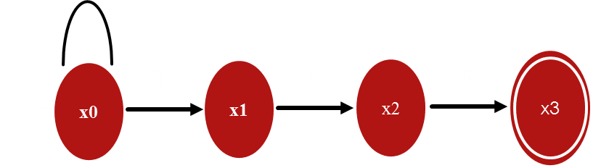
Conversion of NFA into DFA
To convert an NFA to DFA we have to follow following steps
1. Make the Transaction Table of the given NFA
2. Make a DFA transaction table from NFA Transaction Table
3. Draw the DFA from the Transaction Table of DFA.
States / Input | a | b
a/b
- [x0]
[x0,x1]
[x0]
[ x0,x1]
State/Input | a | b
- x0
x0,x1
x0
x1
-----
x2
x2
x3
-----
+ x3
-----
-----

Slide 87
Conversion of NFA into DFA
To convert an NFA to DFA we have to follow following steps
1. Make the Transaction Table of the given NFA
2. Make a DFA transaction table from NFA Transaction Table
3. Draw the DFA from the Transaction Table of DFA.
States / Input | a | b
a/b
- [x0]
[x0,x1]
[x0]
[x0,x1]
[x0,x1]
[x0,x2]
State/Input | a | b
- x0
x0,x1
x0
x1
-----
x2
x2
x3
-----
+ x3
-----
-----

Slide 88
Conversion of NFA into DFA
To convert an NFA to DFA we have to follow following steps
1. Make the Transaction Table of the given NFA
2. Make a DFA transaction table from NFA Transaction Table
3. Draw the DFA from the Transaction Table of DFA.
States / Input | a | b
a/b
- [x0]
[x0,x1]
[x0]
[x0,x1]
[x0,x1]
[x0,x2]
[x0,x2]
[x0,x1,x3]
[x0]
State/Input | a | b
- x0
x0,x1
x0
x1
-----
x2
x2
x3
-----
+ x3
-----
-----

Slide 89
Conversion of NFA into DFA
To convert an NFA to DFA we have to follow following steps
1. Make the Transaction Table of the given NFA
2. Make a DFA transaction table from NFA Transaction Table
3. Draw the DFA from the Transaction Table of DFA.
States / Input | a | b
a/b
- [x0]
[x0,x1]
[x0]
[x0,x1]
[x0,x]
[x0,x2]
[x0,x2]
[x0,x1,x3]
[x0]
State/Input | a | b
+
[x0,x1,x3]
[x0,x1]
[x0,x2]
- x0
x0,x1
x0
b
a
x0
a
x0, x1
b
X0
x2
a
X0
X1
x3
x1
-----
x2
x2
x3
-----
b
a
+ x3
-----
-----
b

Slide 90
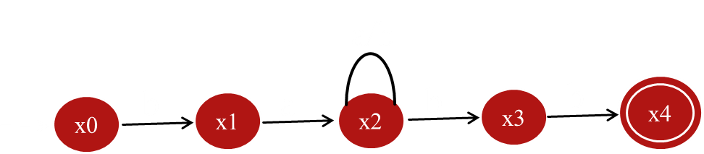
Conversion Example
States / Input | a | b
- [x0]
D
[x1]
States / Input | a | b
- x0
-----
x1
x1
x2
-----
x2
x2
x2,x3
x3
-----
x4
+ x4
-----
-----

Slide 91
Conversion Example
States / Input | a | b
- [x0]
D
[x1]
[x1]
[ x2]
D
States / Input | a | b
- x0
-----
x1
x1
x2
-----
x2
x2
x2,x3
x3
-----
x4
+ x4
-----
-----

Slide 92
Conversion Example
States / Input | a | b
- [x0]
D
[x1]
[x1]
[x2]
D
States / Input | a | b
[x2]
[x2]
[x2,x3]
- x0
-----
x1
x1
x2
-----
x2
x2
x2,x3
x3
-----
x4
+ x4
-----
-----

Slide 93
Conversion Example
States / Input | a | b
- [x0]
D
[x1]
[x1]
[x2]
D
States / Input | a | b
[x2]
[x2]
[x2,x3]
[x2,x3]
[x2]
[x2,x3,x4]
- x0
-----
x1
x1
x2
-----
x2
x2
x2,x3
x3
-----
x4
+ x4
-----
-----

Slide 94
Conversion Example
States / Input | a | b
- [x0]
D
[x1]
[ x1]
[x2]
D
States / Input | a | b
[x2]
[x2]
[x2,x3]
[x2,x3]
[x2]
[x2,x3,x4]
- x0
-----
x1
+
[x2,x3,x4]
[x2]
[x2,x3,x4]
x1
x2
-----
a
x2
x2
x2,x3
b
a
x2
b
x2
x3
x3
-----
x4
x0
x1
+ x4
-----
-----
a
b
b
a
a
D
a/b
x2
X3
x4
b

Slide 95
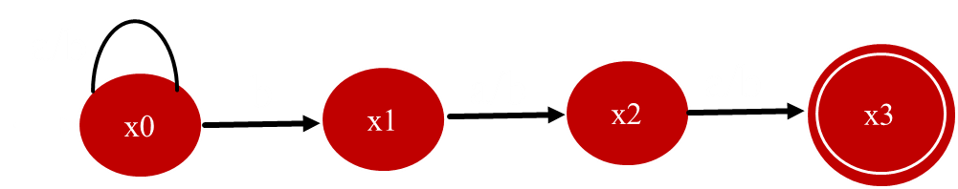
All words that having b as a third last character are valid.
RE = (a+b)* b (a+b)(a+b)
States/Input | a | b
- x0
x0
x0,x1
x1
x2
x2
x2
x3
x3
+ x3
-----
-----

Slide 96
All words that having b as a third last character are valid.
RE = (a+b)* b (a+b)(a+b)
States/Input | a | b
- x0
[x0]
[x0,x1]
States/Input | a | b
- x0
x0
x0,x1
x1
x2
x2
x2
x3
x3
+ x3
-----
-----

Slide 97
All words that having b as a third last character are valid.
RE = (a+b)* b (a+b)(a+b)
States/Input | a | b
- [x0]
[x0]
[x0,x1]
[x0,x1]
[x0,x2]
[x0,x1,x2]
States/Input | a | b
- x0
x0
x0,x1
x1
x2
x2
x2
x3
x3
+ x3
-----
-----

Slide 98
All words that having b as a third last character are valid.
RE = (a+b)* b (a+b)(a+b)
States/Input | a | b
- [x0]
[x0]
[x0,x1]
[x0,x1]
[x0,x2]
[x0,x1,x2]
States/Input | a | b
- x0
x0
x0,x1
[x0,x2]
[x0,x3]
[x0,x1,x3]
x1
x2
x2
x2
x3
x3
+ x3
-----
-----

Slide 99
All words that having b as a third last character are valid.
RE = (a+b)* b (a+b)(a+b)
States/Input | a | b
- [x0]
[x0]
[x0,x1]
[x0,x1]
[x0,x2]
[x0,x1,x2]
States/Input | a | b
- x0
x0
x0,x1
[x0,x2]
[x0,x3]
[x0,x1,x3]
x1
x2
x2
[x0,x3]
[x0]
[x0,x1]
x2
x3
x3
+ x3
-----
-----

Slide 100
All words that having b as a third last character are valid.
RE = (a+b)* b (a+b)(a+b)
States/Input | a | b
- [x0]
[x0]
[x0,x1]
[x0,x1]
[x0,x2]
[x0,x1,x2]
States/Input | a | b
- x0
x0
x0,x1
[x0,x2]
[x0,x3]
[x0,x1,x3]
x1
x2
x2
[x0,x3]
[x0]
[x0,x1]
x2
x3
x3
[x0,x1,x2]
[x0,x2,x3]
[x0,x1,x2,x3]
+ x3
-----
-----

Slide 101
All words that having b as a third last character are valid.
RE = (a+b)* b (a+b)(a+b)
States/Input | a | b
- [x0]
[x0]
[x0,x1]
[x0,x1]
[x0,x2]
[x0,x1,x2]
States/Input | a | b
- x0
x0
x0,x1
[x0,x2]
[x0,x3]
[x0,x1,x3]
x1
x2
x2
[x0,x3]
[x0]
[x0,x1]
x2
x3
x3
[x0,x1,x2]
[x0,x2,x3]
[x0,x1,x2,x3]
+ x3
-----
-----
[x0,x1,x3]
[x0,x2]
[x0,x1,x2]

Slide 102
All words that having b as a third last character are valid.
RE = (a+b)* b (a+b)(a+b)
States/Input | a | b
- [x0]
[x0]
[x0,x1]
[x0,x1]
[x0,x2]
[x0,x1,x2]
[x0,x2]
[x0,x3]
[x0,x1,x3]
States/Input | a | b
[x0,x3]
[x0]
[x0,x1]
- x0
x0
x0,x1
[x0,x1,x2]
[x0,x2,x3]
[x0,x1,x2,x3]
x1
x2
x2
[x0,x1,x3]
[x0,x2]
[x0,x1,x2]
x2
x3
x3
[x0,x2,x3]
[x0,x3]
[x0,x1,x3]
+ x3
-----
-----

Slide 103
All words that having b as a third last character are valid.
RE = (a+b)* b (a+b)(a+b)
States/Input | a | b
- [x0]
[x0]
[x0,x1]
[x0,x1]
[x0,x2]
[x0,x1,x2]
[x0,x2]
[x0,x3]
[x0,x1,x3]
States/Input | a | b
+
[x0,x3]
[x0]
[x0,x1]
- x0
x0
x0,x1
[x0,x1,x2]
[x0,x2,x3]
[x0,x1,x2,x3]
x1
x2
x2
+
[x0,x1,x3]
[x0,x2]
[x0,x1,x2]
x2
x3
x3
+
[x0,x2,x3]
[x0,x3]
[x0,x1,x3]
+ x3
-----
-----
+
[x0,x1,x2,x3]
[x0,x2,x3]
[x0,x1,x2,x3]

Slide 104
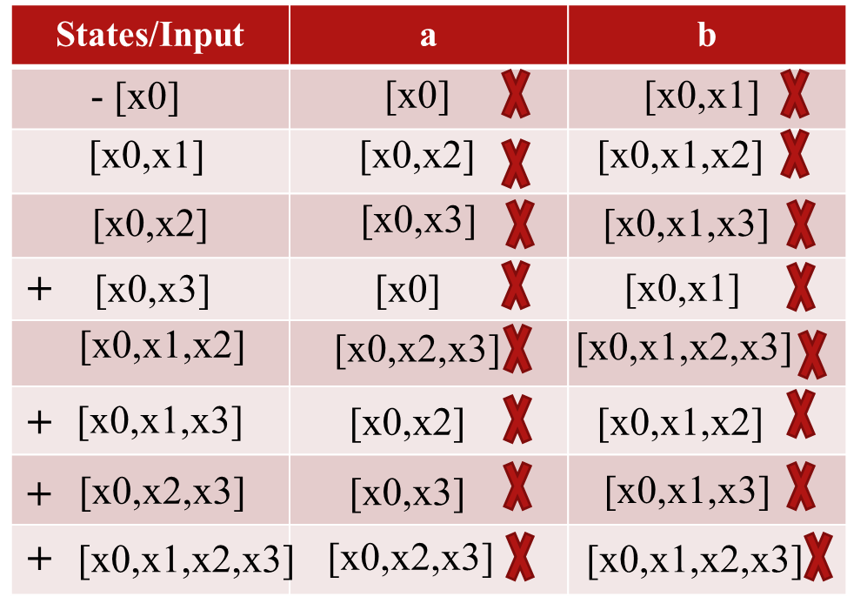
a
a
x0
b
x0x1
a
x0x2
a
x0x3
b
b
a
b
a
X0
X1
x3
b
b
X0
X2
x3
X0
X1
x2
a
a
b
X0
x1
X2
x3
b

Slide 105
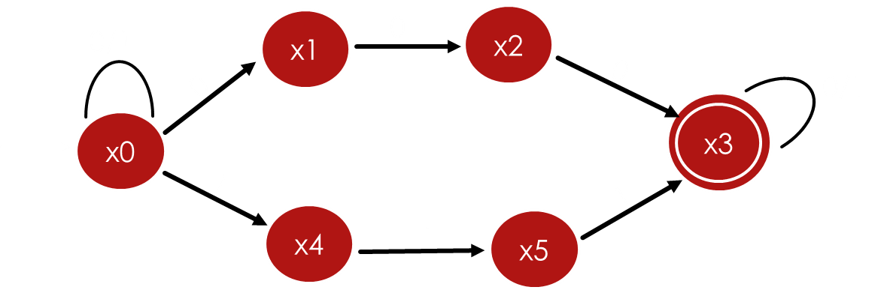
NFA Continue
All words that contains aaa or bbb are valid
RE = (a+b)*aaa (a+b)*
= (a+b)* bbb (a+b)*
RE = [(a+b)*aaa (a+b)*] + [(a+b)* bbb (a+b)*]
RE = (a+b)* (aaa + bbb) (a+b)*
L = {aaa, bbb, aaab,abbb,baaa,bbba,aaaba, aabbb, aaababb, ……….}
Σ = {0,1}
a/b
x1
a
x2
a
a
a/b
x0
x3
b
b
x4
b
x5
Σ = {a,b}

Slide 106
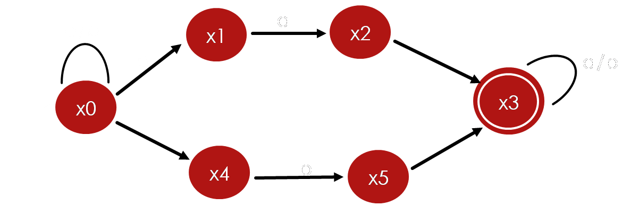
Conversion of NFA into DFA
States / Input | a | b
- x0
[x0,x1]
[x0,x4]
[x0,x1]
States / Input | a | b
- x0
x0,x1
x0,x4
x1
x2
-----
x2
x3
-----
+ x3
x3
x3
x4
-----
x5
x5
-----
x3

Slide 107
Conversion of NFA into DFA
States / Input | a | b
- x0
[x0,x1]
[x0,x4]
[x0,x1]
[x0,x1,x2]
[x0,x4]
[x0,x4]
States / Input | a | b
- x0
x0,x1
x0,x4
x1
x2
-----
x2
x3
-----
+ x3
x3
x3
x4
-----
x5
x5
-----
x3

Slide 108
Conversion of NFA into DFA
States / Input | a | b
- x0
[x0,x1]
[x0,x4]
[x0,x1]
[x0,x1,x2]
[x0,x4]
[x0,x4]
[x0,x1]
[x0,x4,x5]
[x0,x1,x2]
States / Input | a | b
- x0
x0,x1
x0,x4
x1
x2
-----
x2
x3
-----
+ x3
x3
x3
x4
-----
x5
x5
-----
x3

Slide 109
Conversion of NFA into DFA
States / Input | a | b
- x0
[x0,x1]
[x0,x4]
[x0,x1]
[x0,x1,x2]
[x0,x4]
[x0,x4]
[x0,x1]
[x0,x4,x5]
[x0,x1,x2]
[x0,x1,x2,x3]
[x0,x4]
[x0,x4,x5]
States / Input | a | b
- x0
x0,x1
x0,x4
x1
x2
-----
x2
x3
-----
+ x3
x3
x3
x4
-----
x5
x5
-----
x3

Slide 110
Conversion of NFA into DFA
States / Input | a | b
- x0
[x0,x1]
[x0,x4]
[x0,x1]
[x0,x1,x2]
[x0,x4]
[x0,x4]
[x0,x1]
[x0,x4,x5]
[x0,x1,x2]
[x0,x1,x2,x3]
[x0,x4]
[x0,x4,x5]
States / Input | a | b
- x0
x0,x1
x0,x4
x1
x2
-----
x2
x3
-----
+ x3
x3
x3
x4
-----
x5
x5
-----
x3

Slide 111
Conversion of NFA into DFA
States / Input | a | b
- x0
[x0,x1]
[x0,x4]
[x0,x1]
[x0,x1,x2]
[x0,x4]
[x0,x4]
[x0,x1]
[x0,x4,x5]
[x0,x1,x2]
[x0,x1,x2,x3]
[x0,x4]
[x0,x4,x5]
[x0,x1]
[x0,x3,x4,x5]
[x0,x1,x2,x3]
States / Input | a | b
- x0
x0,x1
x0,x4
x1
x2
-----
x2
x3
-----
+ x3
x3
x3
x4
-----
x5
x5
-----
x3

Slide 112
Conversion of NFA into DFA
States / Input | a | b
- x0
[x0,x1]
[x0,x4]
[x0,x1]
[x0,x1,x2]
[x0,x4]
[x0,x4]
[x0,x1]
[x0,x4,x5]
[x0,x1,x2]
[x0,x1,x2,x3]
[x0,x4]
[x0,x4,x5]
[x0,x1]
[x0,x3,x4,x5]
[x0,x1,x2,x3]
[x0,x1,x2,x3]
[x0,x3,x4]
States / Input | a | b
[x0,x3,x4,x5]
- x0
x0,x1
x0,x4
x1
x2
-----
x2
x3
-----
+ x3
x3
x3
x4
-----
x5
x5
-----
x3

Slide 113
Conversion of NFA into DFA
States / Input | a | b
- x0
[x0,x1]
[x0,x4]
[x0,x1]
[x0,x1,x2]
[x0,x4]
[x0,x4]
[x0,x1]
[x0,x4,x5]
[x0,x1,x2]
[x0,x1,x2,x3]
[x0,x4]
[x0,x4,x5]
[x0,x1]
[x0,x3,x4,x5]
[x0,x1,x2,x3]
[x0,x1,x2,x3]
[x0,x3,x4]
States / Input | a | b
[x0,x3,x4,x5]
[x0,x1,x3]
[x0,x3,x4,x5]
- x0
x0,x1
x0,x4
[x0,x1,x3]
x1
x2
-----
x2
x3
-----
+ x3
x3
x3
x4
-----
x5
x5
-----
x3

Slide 114
Conversion of NFA into DFA
States / Input | a | b
- x0
[x0,x1]
[x0,x4]
[x0,x1]
[x0,x1,x2]
[x0,x4]
[x0,x4]
[x0,x1]
[x0,x4,x5]
[x0,x1,x2]
[x0,x1,x2,x3]
[x0,x4]
[x0,x4,x5]
[x0,x1]
[x0,x3,x4,x5]
[x0,x1,x2,x3]
[x0,x1,x2,x3]
[x0,x3,x4]
States / Input | a | b
[x0,x3,x4,x5]
[x0,x1,x3]
[x0,x3,x4,x5]
- x0
x0,x1
x0,x4
[x0,x1,x3]
[x0,x1,x2,x3]
[x0,x3,x4]
x1
x2
-----
[x0,x3,x4]
x2
x3
-----
+ x3
x3
x3
x4
-----
x5
x5
-----
x3

Slide 115
Conversion of NFA into DFA
States / Input | a | b
- x0
[x0,x1]
[x0,x4]
[x0,x1]
[x0,x1,x2]
[x0,x4]
[x0,x4]
[x0,x1]
[x0,x4,x5]
[x0,x1,x2]
[x0,x1,x2,x3]
[x0,x4]
[x0,x4,x5]
[x0,x1]
[x0,x3,x4,x5]
+
[x0,x1,x2,x3]
[x0,x1,x2,x3]
[x0,x3,x4]
+
States / Input | a | b
[x0,x3,x4,x5]
[x0,x1,x3]
[x0,x3,x4,x5]
- x0
x0,x1
x0,x4
+
[x0,x1,x3]
[x0,x1,x2,x3]
[x0,x3,x4]
x1
x2
-----
+
[x0,x3,x4]
[x0,x1,x3]
[x0,x3,x4]
x2
x3
-----
+ x3
x3
x3
x4
-----
x5
x5
-----
x3

Slide 116
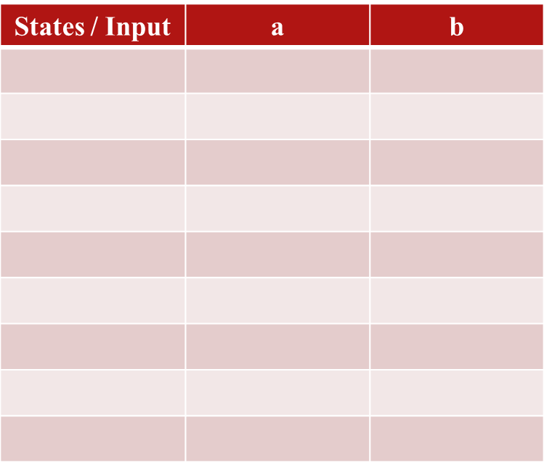
a
- x0
[x0,x1]
[x0,x4]
X0
X1
x2
a
[x0,x1]
[x0,x1,x2]
[x0,x4]
a
a
X0
x1
X2
x3
x0
x0x1
[x0,x4]
[x0,x1]
[x0,x4,x5]
[x0,x1,x2]
[x0,x1,x2,x3]
[x0,x4]
b
a
a
[x0,x4,x5]
[x0,x1]
[x0,x3,x4,x5]
b
+
b
a
X0
X1
x3
b
[x0,x1,x2,x3]
[x0,x1,x2,x3]
[x0,x3,x4]
+
X0
X4
x5
b
[x0,x3,x4,x5]
[x0,x1,x3]
[x0,x3,x4,x5]
x0x4
b
+
[x0,x1,x3]
[x0,x1,x2,x3]
[x0,x3,x4]
X0
X3
x4
a
+
[x0,x3,x4]
[x0,x1,x3]
[x0,x3,x4]
a
b
X0
X3
x4
x5
b
b

